Slide 1


ECE 281
1

Slide 2
Bitbucket.org
Please double check your CEs/Labs online to ensure there are no errors
Grades and feedback is through the issue tracker
Git tracks all changes with time/date stamp
You can easily view the changes and when they occurred through bitbucket’s online interface

Slide 3
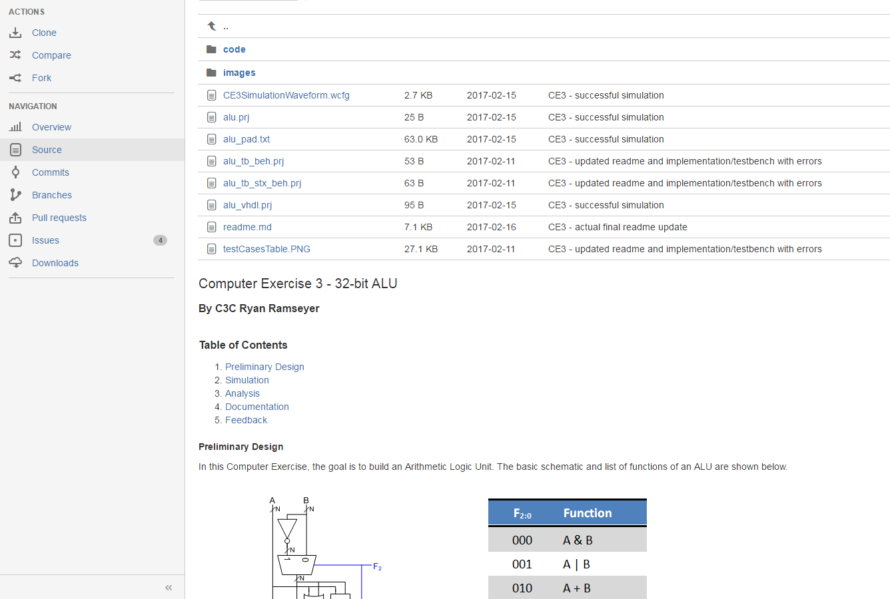
What I Expect

Slide 4
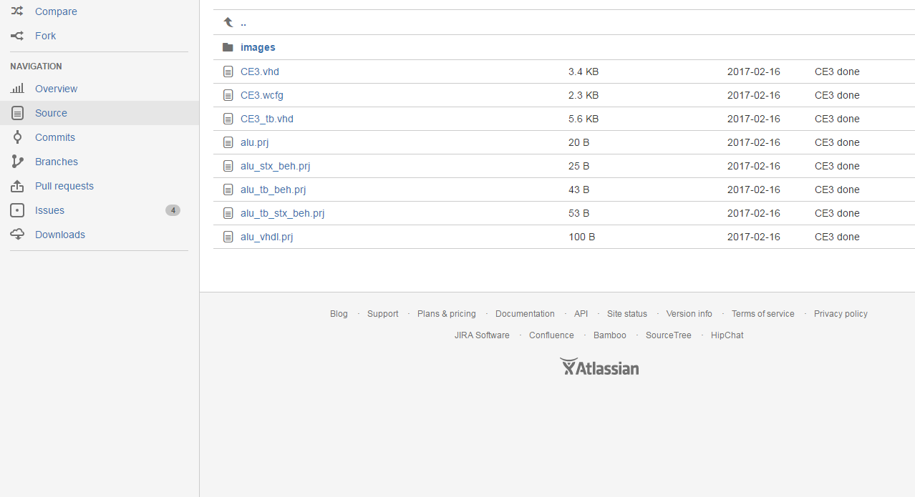
What I See for CE 3
Screen grab made 28 Feb 2017
CE3 due 16 Feb 2017

Slide 5
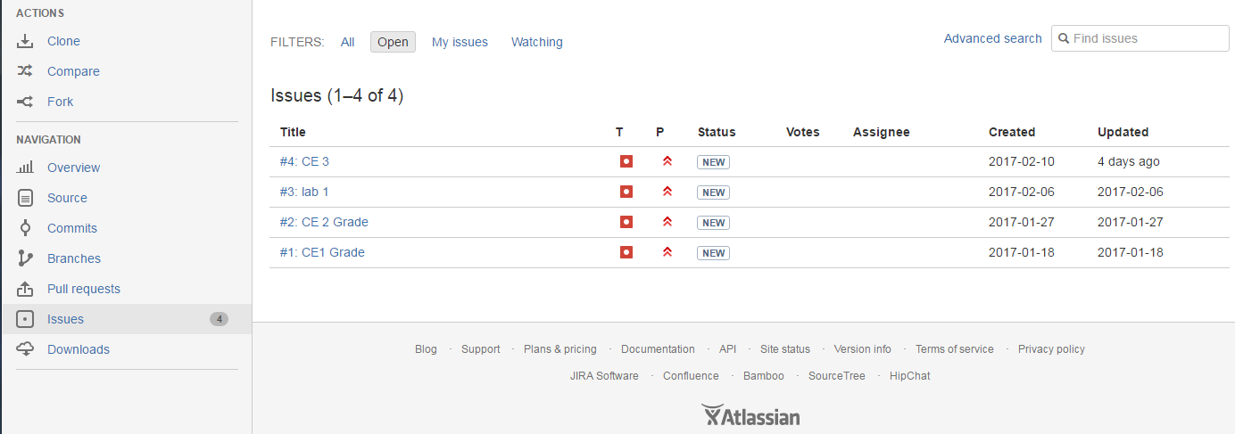
How I Notify You
I create issues for each CE/Lab and you should get an email when it is created

Slide 6
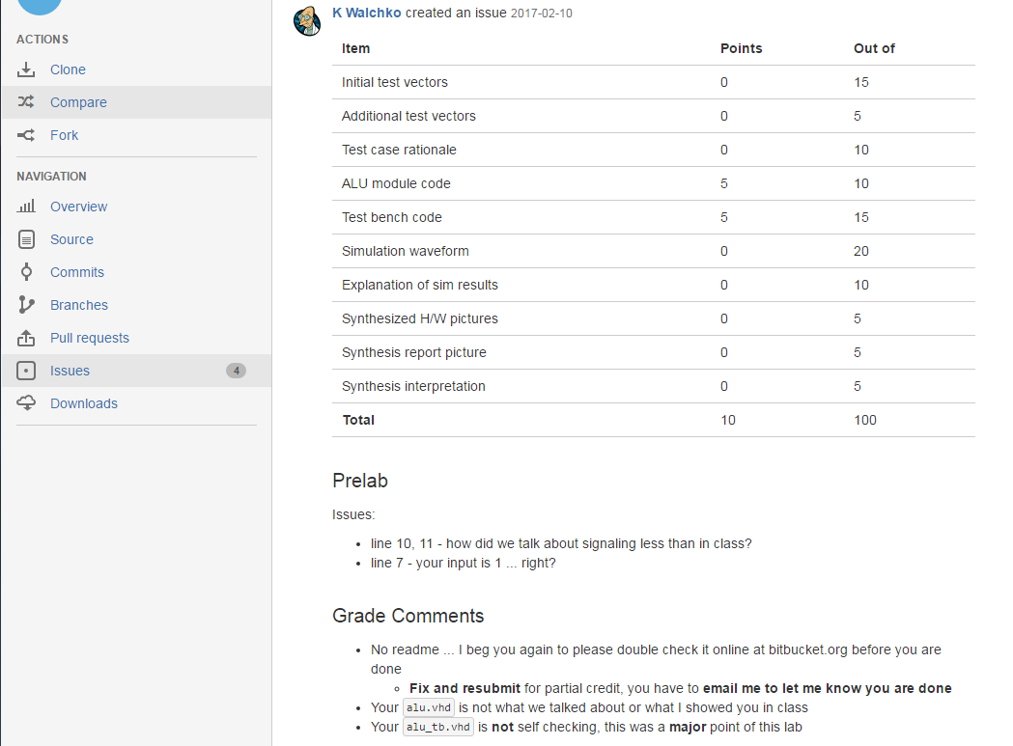
Grades, Feedback, 2nd Chances
Do not send me files via email! Your assignment is to write a lab report (readme.md) and post it on bitbucket.org
Please re-do the work

Slide 7
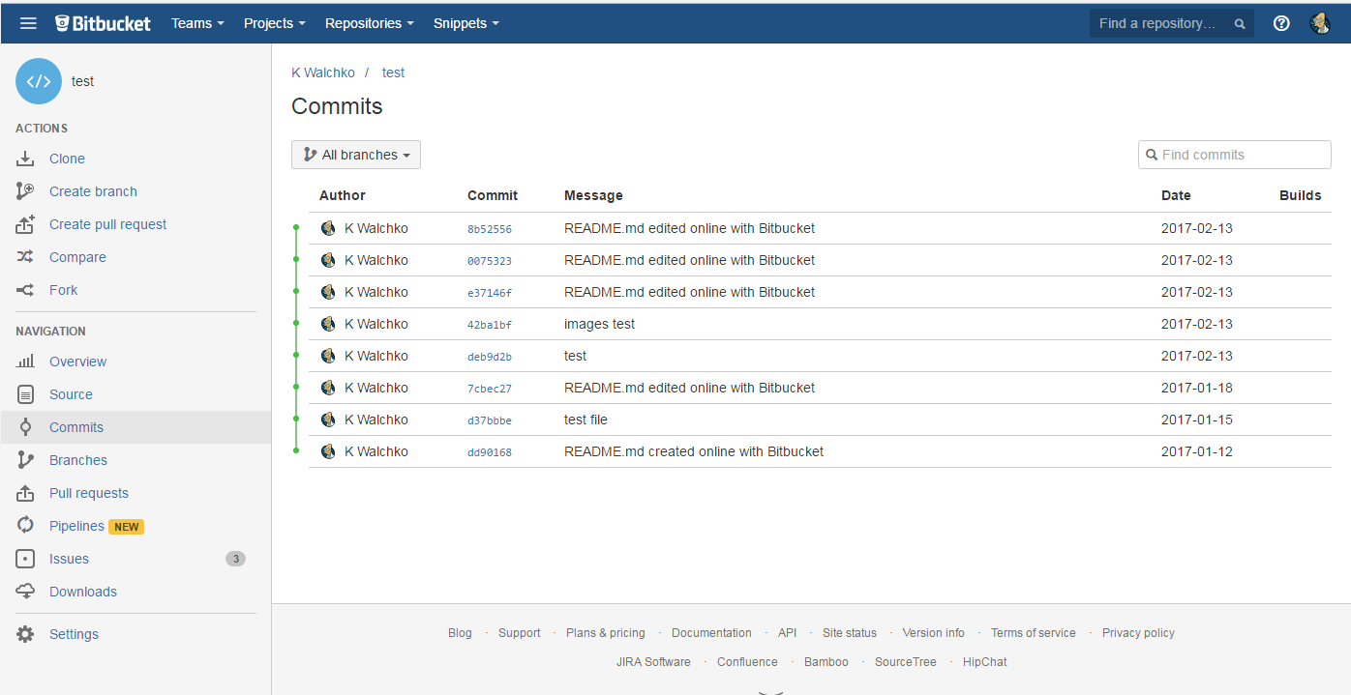
Git Commits
Commit IDs
Commit messages help me find what I need
Dates of commit

Slide 8
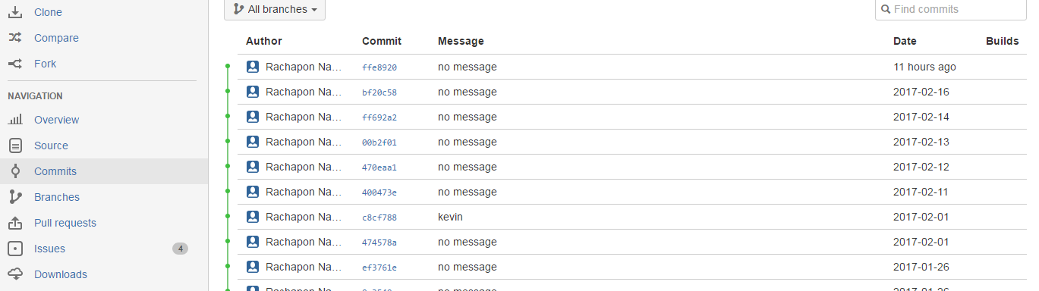
Commit Messages
Unacceptable
You need to follow the format we outlined in CE2
CE4 fixed typos in readme for regrade
Lab3 initial commit
2 parts to a commit message
CE/Lab
Some meaningful message
This helps me find things in your repo so I can regrade or double check things

Slide 9
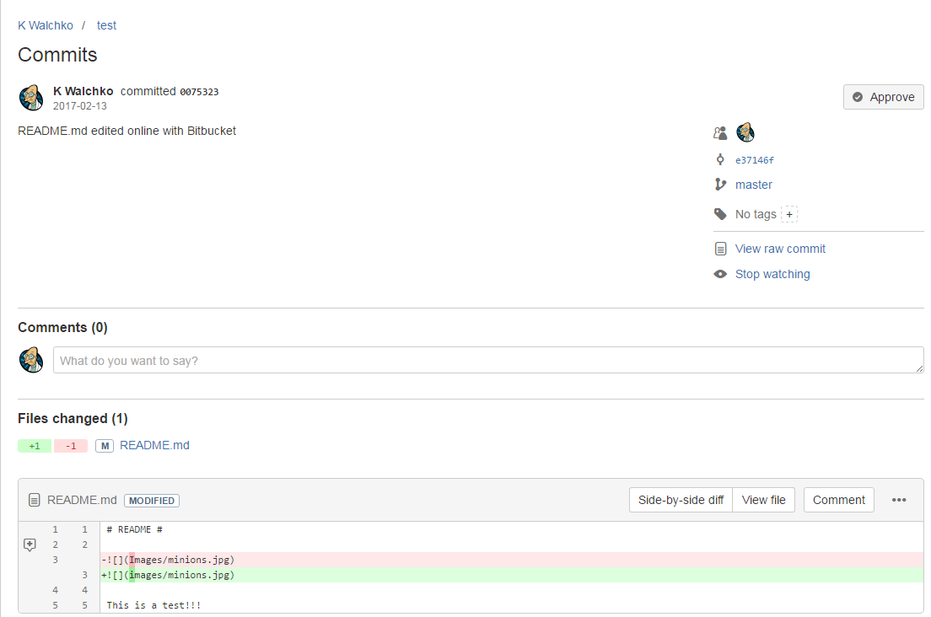
Looking at a commit
Clicking on a commit ID gives you this page
Date
Get more info
Changes to file

Slide 10
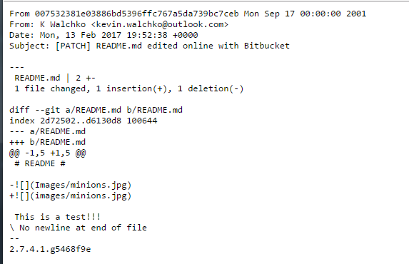
Raw Commit
Date and time (GMT)
This is a diff between what is on bitbucket and what is in my local repo

Slide 11
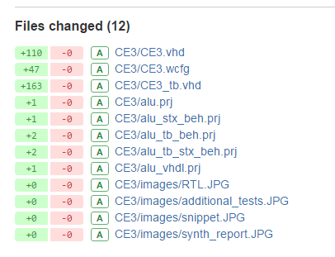
Example Repo
Binary images have no lines of code
This is the full commit for a student for CE 3, notice, there is no readme.md in any file uploaded to bitbucket.org

